Slide 1
Enrich LA Sustainability Plan
10/23/2018

Slide 2
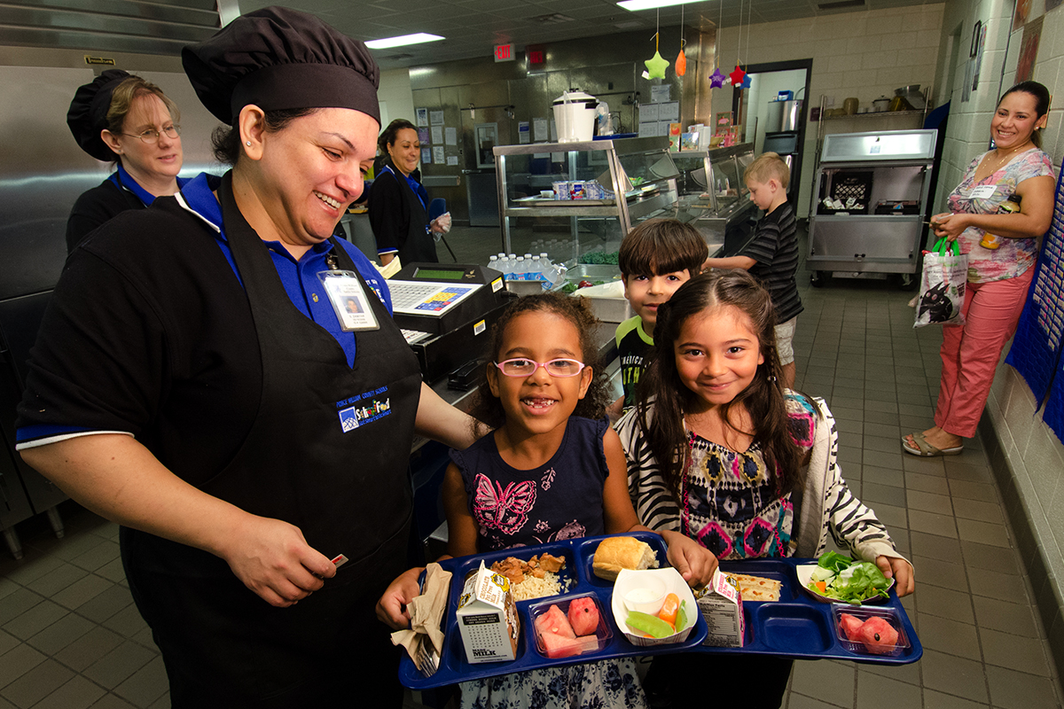
Index
Micheltorena Background
Research
Goals
Laboral Resources
Cost
What’s Realistic?

Slide 3
Micheltorena Objective
The principal and parent volunteers have expressed interest in creating workable compost as a goal for this school year.
We are in the discovery phase of how to get this done, and how to be SUCCESSFUL at it!
We need signage to identify what can be salvaged for recycling, what can be composted and what belongs in a landfill.

Slide 4
Goals and Benchmarking
Step 1: Will be to identify what the true goals are within the school, parents and administration. Identify what we mean when we say compost – do we mean reduce the landfill waste and compost is one part of this?
Step 2: Who will contribute, set and maintain calendar and volunteers
Step 3: Define success and goals
Waste
Stream
Recycle
Compost
Trash

Slide 5
Research
Capacity
What type of compost to implement
What is the capacity in weight and over time
Labor
Who will volunteer to turn and manage compost daily?
Who will transport compost?
Cost
How much will it cost?
How will we fundraise to build what we need?
Who are the internal stakeholders?

Slide 6
Implementation Plan and Rollout
February 2019

Slide 7
Implementation Micheltorena Elementary School
Roll out February 2019
Food found in trash
Disposal Line – rethinking food waste
Communicating and training school staff
Scheduling and Managing Volunteers
Measuring success
Keeping school engaged

Slide 8
CURRENT
CURRENT - ALL TRASH DISPOSAL
NO RECYCLING AT LUNCH
NO REUSING FOOD
COMPOST GOING IN TRASH
SEALED PACKAGES GOING IN TRASH
ONE BIN COLLECTION SYSTEM

Slide 9
Micheltorena Lunch and Waste Management Goals
Kids eat fruits and vegetables
Find non-profit to accept excess food
On-site compost
Organics Waste - vendor
Recycle - vendor
Trash

Slide 10
Resources: administration, teachers, staff, volunteers
Kids
Lunch
Staff
Enrich
LA
Parents
Site
Manager

Slide 11
(Dis)Assembly Line
Eat
Lunch
Trash
Kids
Lunch support staff
Site manager
Share Table
Recycle
Food
Glean
On-site
Compost
Vendor
Compost
MES Admin
Lunch Admin
Enrich LA
Parents
Notes:
Share table potentially not possible due to allergies
Food Glean – donating perfectly good, sealed foods to a non-profit. Made calls to food forward 2/20
Emailed vendor for compost – waiting for documentation information about separation
Waiting on vendor to confirm recycle materials and containers

Slide 12
Benefits to Garden
Reduction of food waste
Reusing food and vegetables
Teaching Children origins and end of cycle of food production
Compost stays local, we benefit by increasing soil production, reducing cost
Parents and school work together for a common goal
Ability to compete for local school grants

Slide 13
Schedule
Stakeholders | Spring 2019 | Fall 2019 | Winter 2019 | Spring 2019
Enrich LA
Micheltorena Admin
Site Manager
Lunch Staff
Parents
Kids
Low Impact
Med Impact
High Impact

Slide 14
Next Steps
Waiting on vendor information – re: compost (Alex outreach to Cynthia/Tania)
Recycle information from vendor – plastics (Alex outreach to Cynthia/Tania)
Food Glean – food forward (Alex outreach to FF, discuss with Ms. Sakellario and lunch staff to see if this is possible?)
Need to inform parents of changes, and request volunteers – Ms. Sakellarion
Training Parents
Training Students
Sharing developments with teachers and lunch staff
Scale to track
Google Document to schedule shifts
Help Kids establish their garden club - TBD

